Slide 1


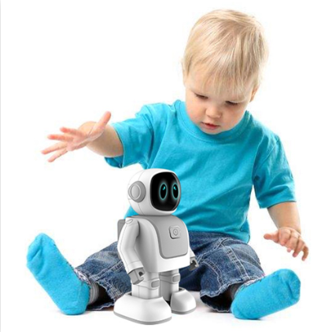
An Intelligent Robot For Monitoring And Protecting Toddlers
2023-326

Slide 2






Members
Co – Supervisor :
Rangi Liyanage
Supervisor :
Prof.Sanath Jayawardhne
Member 01 – Ravindu Thuduhena
Member 02 –
Shamal weerarthne
Member 03 –
Ravishka Lakshan
Member 04 –
Danuka Maddepola

Slide 3
CONTENTS
INTRODUCTION
RESEARCH PROBLEMS
OBJECTIVES
SYSTEM OVERVIEW DIAGRAM
INDIVIDUAL PROGRESS
Objectives & Project Completion
OVERALL PROGRESS
Next Expected Progress
BUDGET
Project Evidence

Slide 4


INTRODUCTION
Modern parents have busy schedules, domestic duties, and parenting responsibilities because of that, it is difficult for them to constantly keep an eye on toddlers.
Proposed project: build an intelligent robot that remotely watches children, detects unauthorized presence, and alert parents.
Main targeted beneficials are parents of toddlers age between 2 – 4. Additionally, this product can be developed targeting for childcare centres, playgrounds and nursery schools.
Technologies used to build the proposed project: Robotics, AI, ML, Image Processing, Open CV
Functionalities:
Following the toddler and obstacle avoidance-based navigation.
Monitoring the toddler constantly while identify threats & environmental conditions.
Expelling animals that can be threatened to the toddler.
Automatically play lullabies when toddler crying.
Send alerts to the parents after capturing the child behaviours.

Slide 5

Research Problems
Lack of sufficient supervision: Parents and caregivers may struggle to provide constant supervision for their toddlers.
Safety: Toddlers may be prone to accidents and injuries, particularly when left unsupervised.
Limitation for Communication: Parents are unable to interact with their babies directly when they are away.
Lack of flexibility to monitor while following toddler: There is no an efficient way to monitor the toddler while he is moving around.

Slide 6

RESEARCH OBJECTIVES
Main Objective
To develop a robot capable of caring for toddlers in the absence of their parents. Overall, the research aims to create a technology that can enhance child safety and provide peace of mind for parents and caregivers.

Slide 7

Sub Objectives
Developing a navigation system for the robot that can effectively and safely navigate around the toddler, incorporating the obstacle avoidance navigation and safe movement.
To establish a virtual monitoring system for the toddler's surroundings to provide parental oversight, detect any unauthorized presence and safeguard the toddler from identifying potential threats to the child's safety.
Create a system to identify toddler behaviours and notify parents when necessary.
Create music and lullabies playing system to calm down the toddler and help him to relax.
Create graphical user interface as a mobile application for parents to easily controlling and visualize the things.

Slide 8
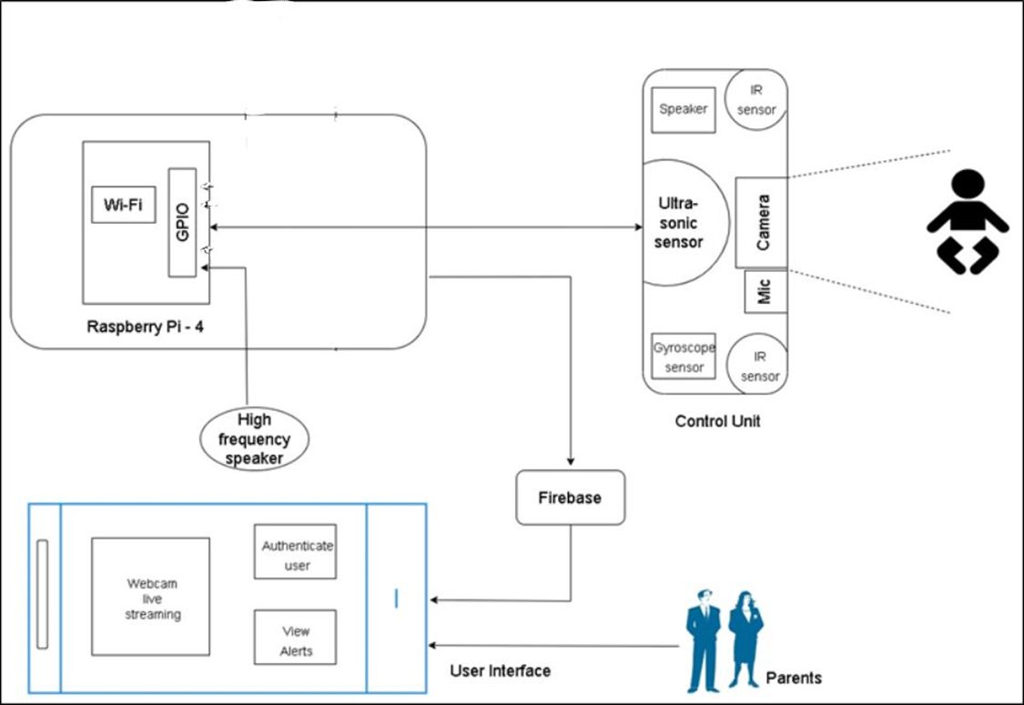
Overall System Diagram

Slide 9

IT20185466 | R.S Thuduhena
BSc (Hons) in Information Technology
Specializing in Computer Systems & Network Engineering

Slide 10
Component -1
- Toddler Following and Obstacle Avoidance Robust Navigation System -

Slide 11
Introduction
Why toddler protecting robot needs navigation system ?
How this robot help to parents and
childcare givers ?
How robot follow the toddler ?
how robot identify the obstacles ?

Slide 12


Research Problem
How can we design and develop a secure and robust robot navigation system that can navigate around a toddler, utilizing obstacle avoidance techniques and safe mobility, while still allowing for non-threatening human-robot interaction, even in scenarios where the child may engage with or damage the robot.

Slide 13


Specific Objective
To develop a navigation system for the robot that can effectively and safely navigate around the toddler, incorporating the obstacle avoidance navigation and safe movement.

Slide 14

Sub Objectives
To effectively and safely navigate around a toddler.
To accurately tracking and following the toddler.
Incorporating the obstacle avoidance navigation.
Robot must be able to clear the area intelligently, for instance if the child interacts with or destroys it.
To engage in non-threatening human-robot interaction with a toddler.

Slide 15

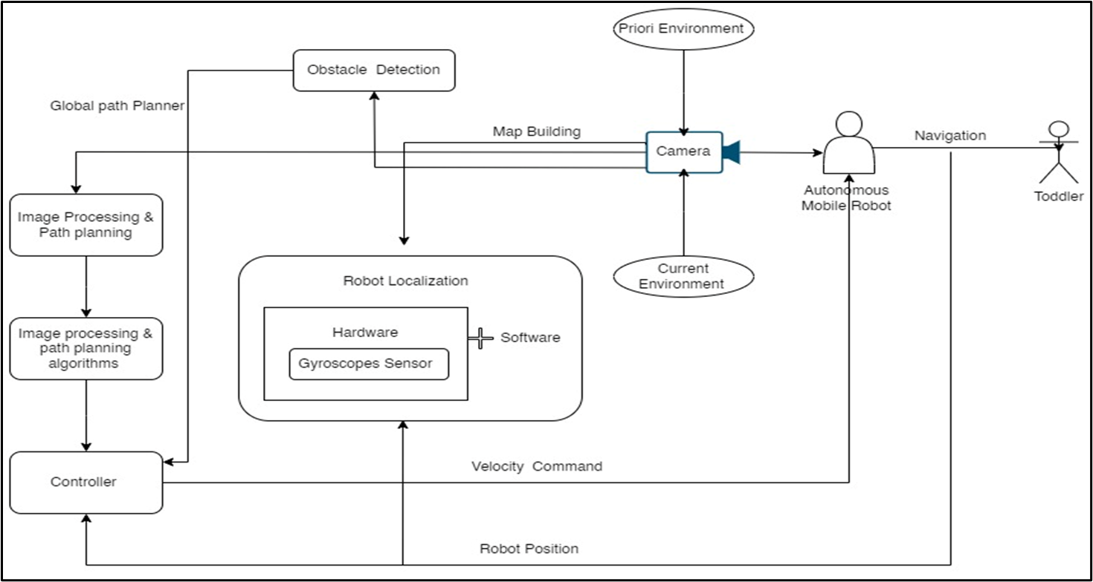
Methodology

Slide 16

Current Progress
Implementation of the pi-camera module and web camera module to track the toddler.
Implementation of the toddler tracking system is completed.
Configure the speed of the tracking object and positions of the object.
Setup the 2 motor driver and 4-motors.

Slide 17

OBJECTIVES AND PROJECT COMPLETION
90%
50%
Complete the toddler following and tracking system parts.
Setup all motor drivers and motor with robot.
Implementation of ML Model to recognize the tracking Object.
Setup Pi-camera module and web cam module
Configure the tracking system.
70%
Develop The ML Model for Object avoidance navigation
Improving the model for safety navigation of robot

Slide 18
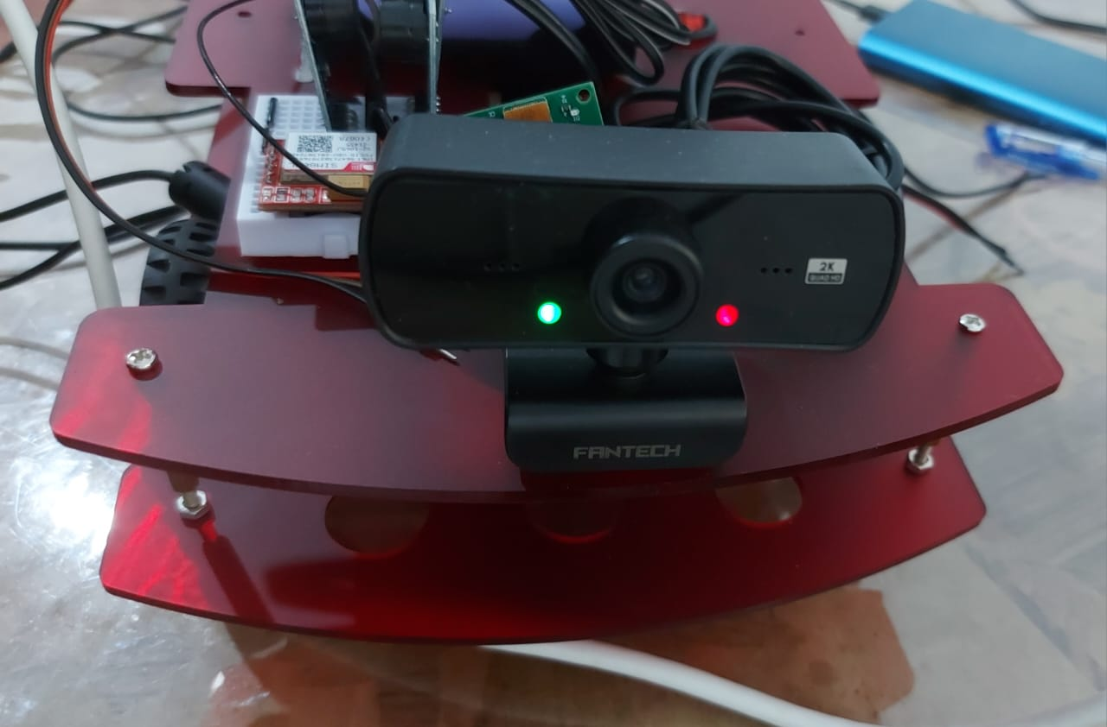
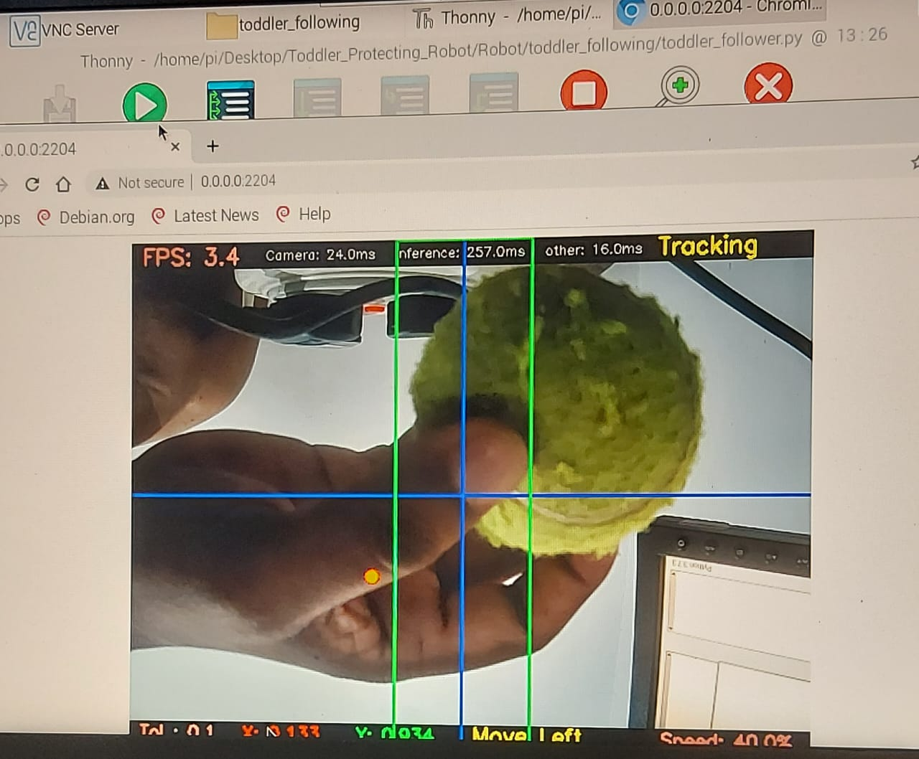
Project Evidence

Slide 19
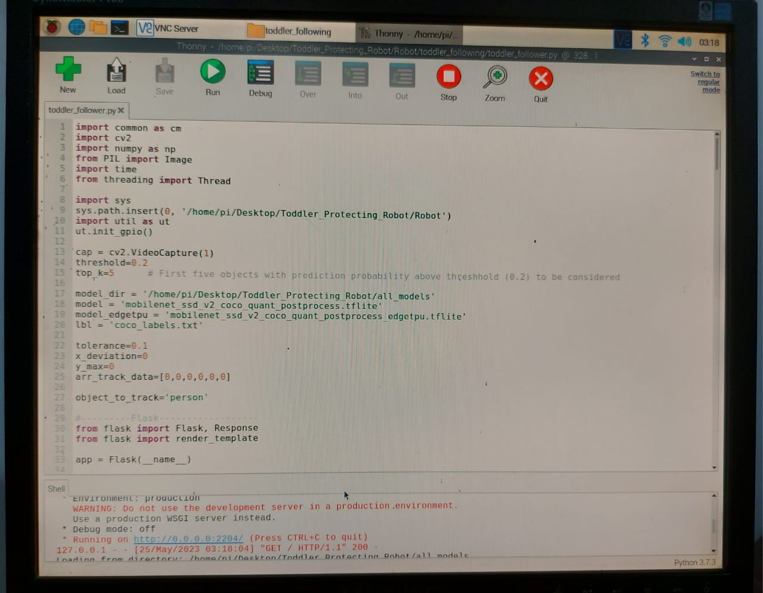

Slide 20
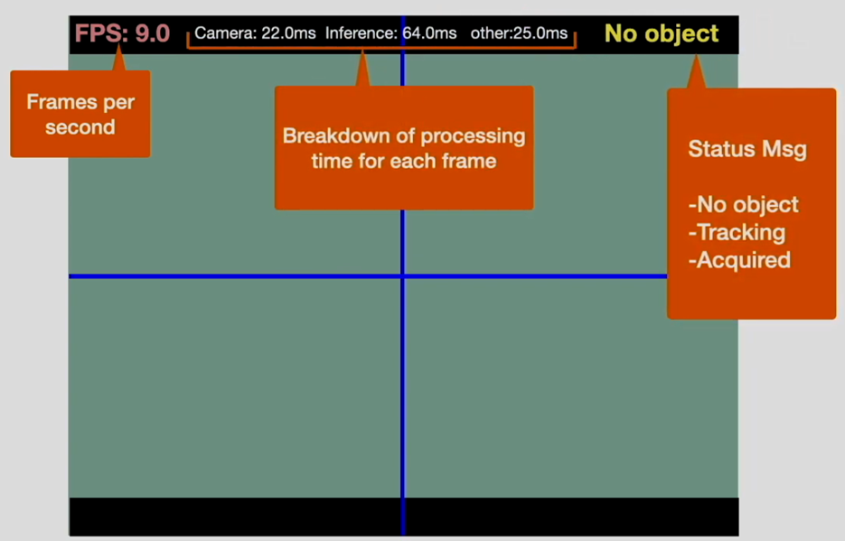
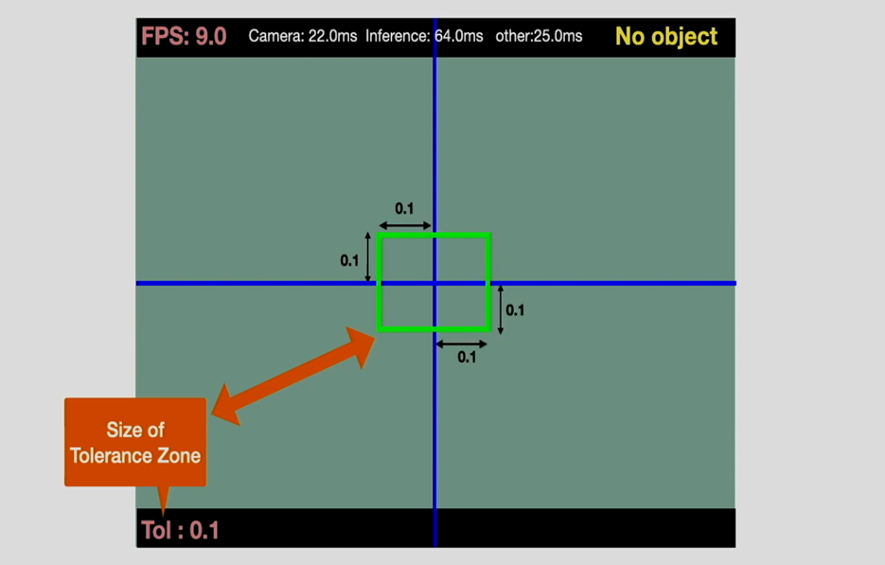
Project Evidence

Slide 21
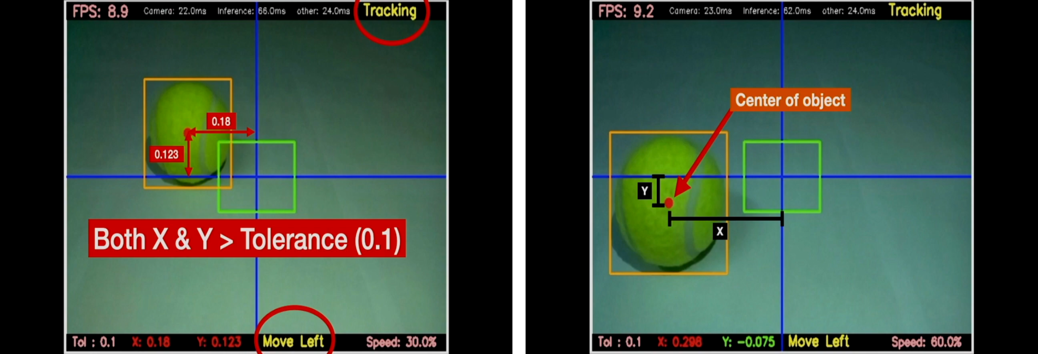

Slide 22


Next Expected Progress
Complete the Toddler tracking and following system.
Continuously Improving the ML Model Performance
Complete the toddler following and tracking system parts.
Setup all motor drivers and motor with robot.

Slide 23
IT20280956 | Weerarathne R.M.S.S.
BSc (Hons) in Information Technology
Specializing in Computer Systems & Network Engineering

Slide 24
Component - 2
-Toddler Monitoring & Animal Detection System -

Slide 25
Introduction
How to accurately monitor the toddlers
in the absence of their parents?
How to detect un-authorized access to the child?
How to expel threatened animals using humane method?

Slide 26
Research Problem
The unavailability of an efficient and accurate system that provides virtual surveillance of toddlers' surroundings to detect possible threats to the kid. Also, expulsion of animals that can be threatened to the toddler using humane and non-invasive approaches.

Slide 27
Objectives
Specific Objective:
To design and develop a system for the robot that can offer virtual monitoring of a toddler's surroundings while safeguard him.
Sub Objectives:
To real-time detect any unpermitted presence.
To identify potential threats to the child's safety.
To expel animals that can be threatened to toddler without harm for both animal and toddler.

Slide 28
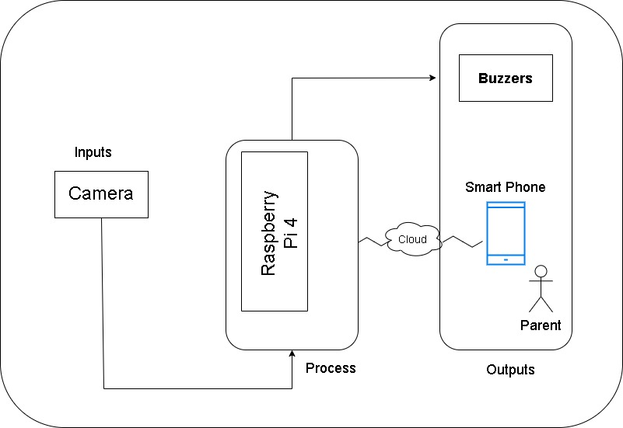
Methodology

Slide 29
Current Progress
Implementation of cameras to detect objects.
Cameras can capture the video of toddlers’ surroundings.
Implementation of animal detection system.
Trained a dataset through Open CV for detecting two domestic animals. (dog, and cat)

Slide 30

Objectives and Project Completion
75%
85%
Animal Detection
Increase the efficiency of camera module.
Increase reliability of detecting animals.
Expelling animals
Complete all component implementation including passive buzzers.
Generate high-frequency sound for each animals accordingly.

Slide 31
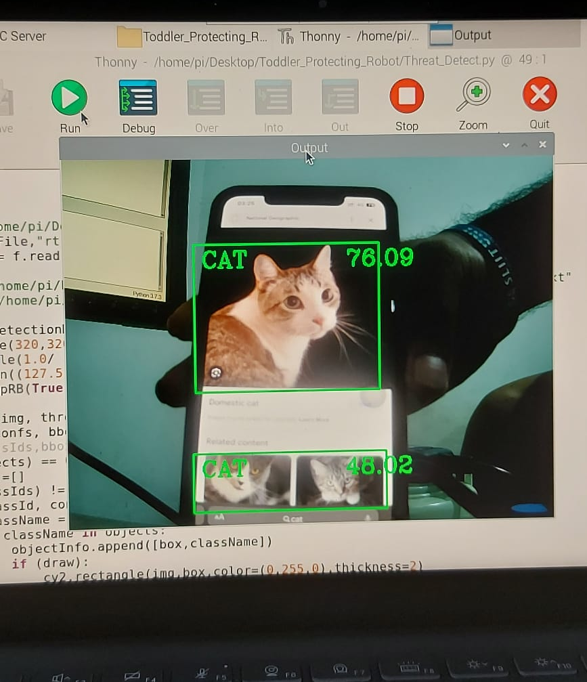
Project Evidence

Slide 32
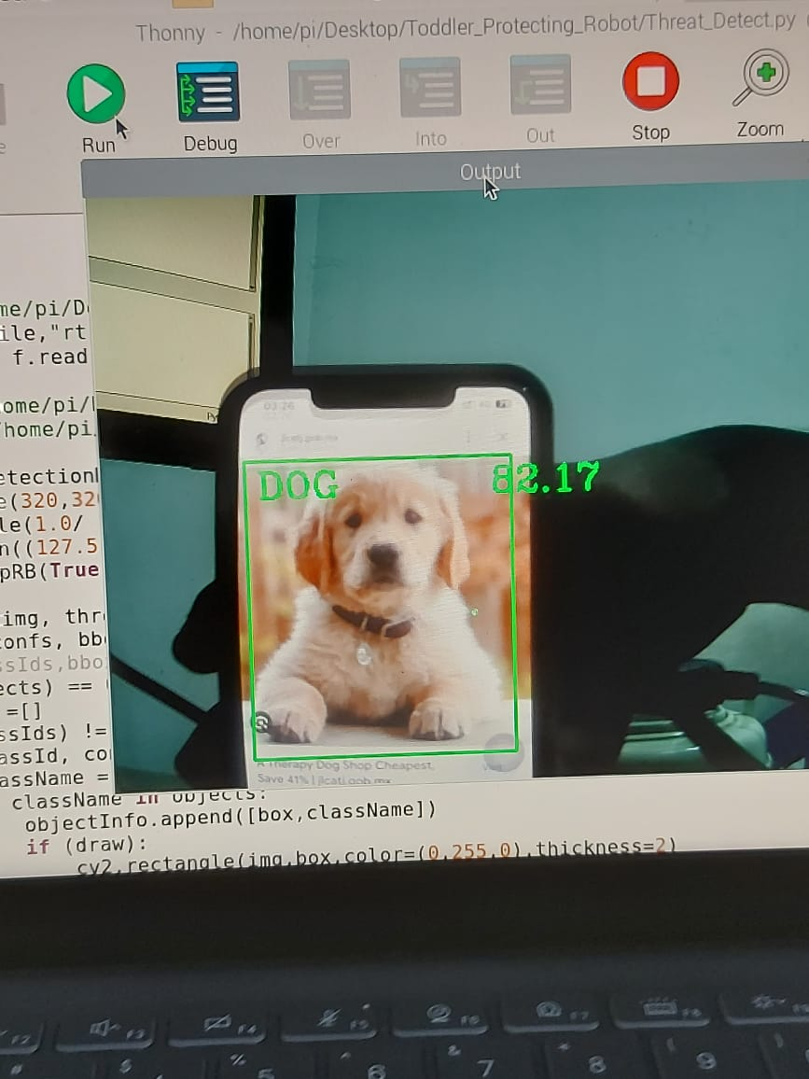
Project Evidence

Slide 33

Next Expected Progress
Identify frequency ranges sensible for different animals.
Generate a high-frequency sound.
Implement a toddler monitoring system through the web camera.
Increase the reliability of detecting animals.

Slide 34
IT20136260 | Maddepola M.A.D.K.B
BSc (Hons) in Information Technology
Specializing in Computer Systems & Network Engineering

Slide 35
Component - 3
Toddler Behavior Detection & Alerting System

Slide 36
Introduction
Parental concerns about understanding child's behavior and surroundings when they are away are prevalent.
Existing methods of communication often fail to provide accurate and timely information to parents regarding their child's behavior and environment.
The research aims to develop an alerting system that accurately detects and informs parents about their child's behavior.

Slide 37
Research Problem
A parent cannot get a proper understanding of the child's behaviour and the child’s surroundings when they are away from the child.
There is no proper way to give an accurate message to parents about child's behaviour or the environment of the child.

Slide 38
Specific Objective
Specific Objective:
Creating an alerting system that can accurately detect the behavior of the child and inform the parents about it.
Informing parents through an alert when the child is about to enter a dangerous area.
Detects the child's behavior when he kneels or falls and alerts the parents through an alerting system.
Novelty- Capturing the child's behavior and providing an accurate alert to the parents.

Slide 39
Sub Objectives
Integrating with all team members in order to assemble the
robot and develop the user interface.

Slide 40
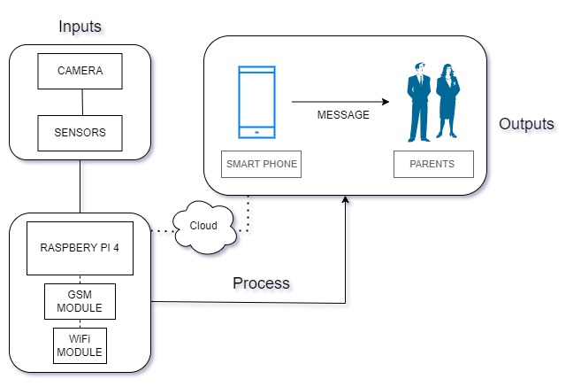
Methodology

Slide 41
Current Progress
Connecting and implementing SIM Module.
Implementing SIM module antenna.
Installing pi camera and web camera for behavior capturing part.
Installing of alerting system by providing external power.

Slide 42
OBJECTIVES AND PROJECT COMPLETION
85%
70%
Behaviour capturing
Complete the module training section.
Complete the behaviour capture part
Complete the relevant coding part.
Alerting System
All hardware components sourced
Physical device implemented
Install and connect the SIM module to the system so that the power supply can be balanced.

Slide 43
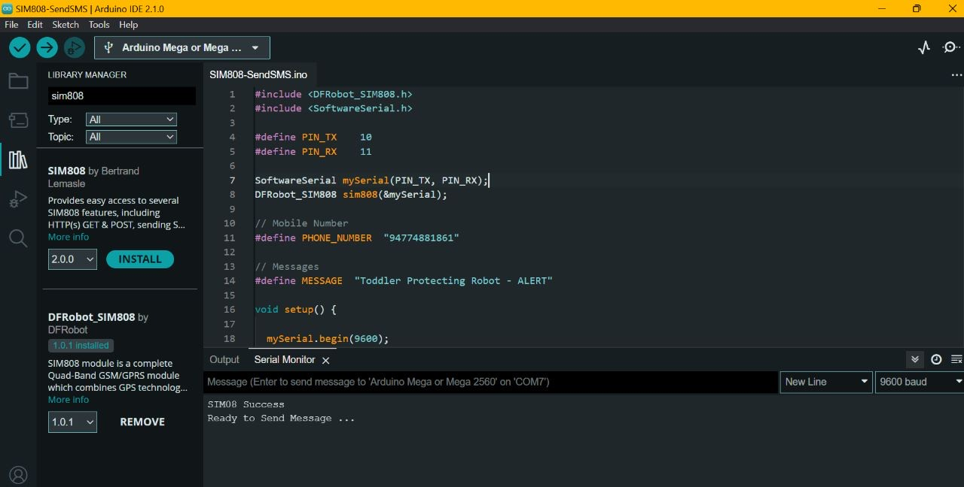
Project Evidence

Slide 44
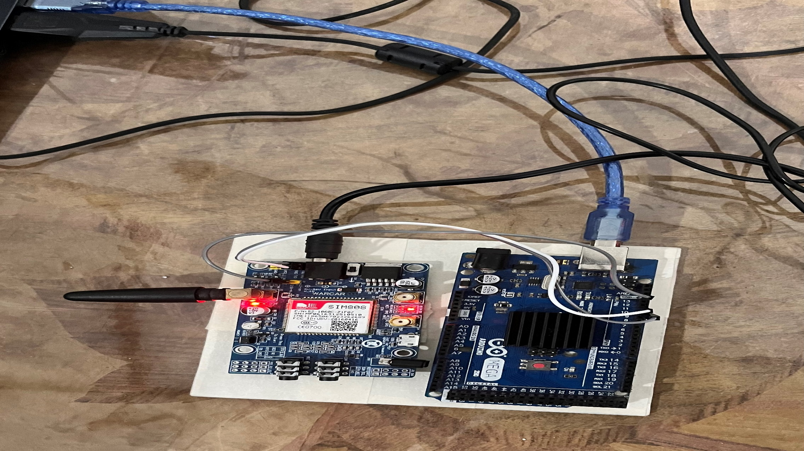
Project vidence
Project Evidence

Slide 45
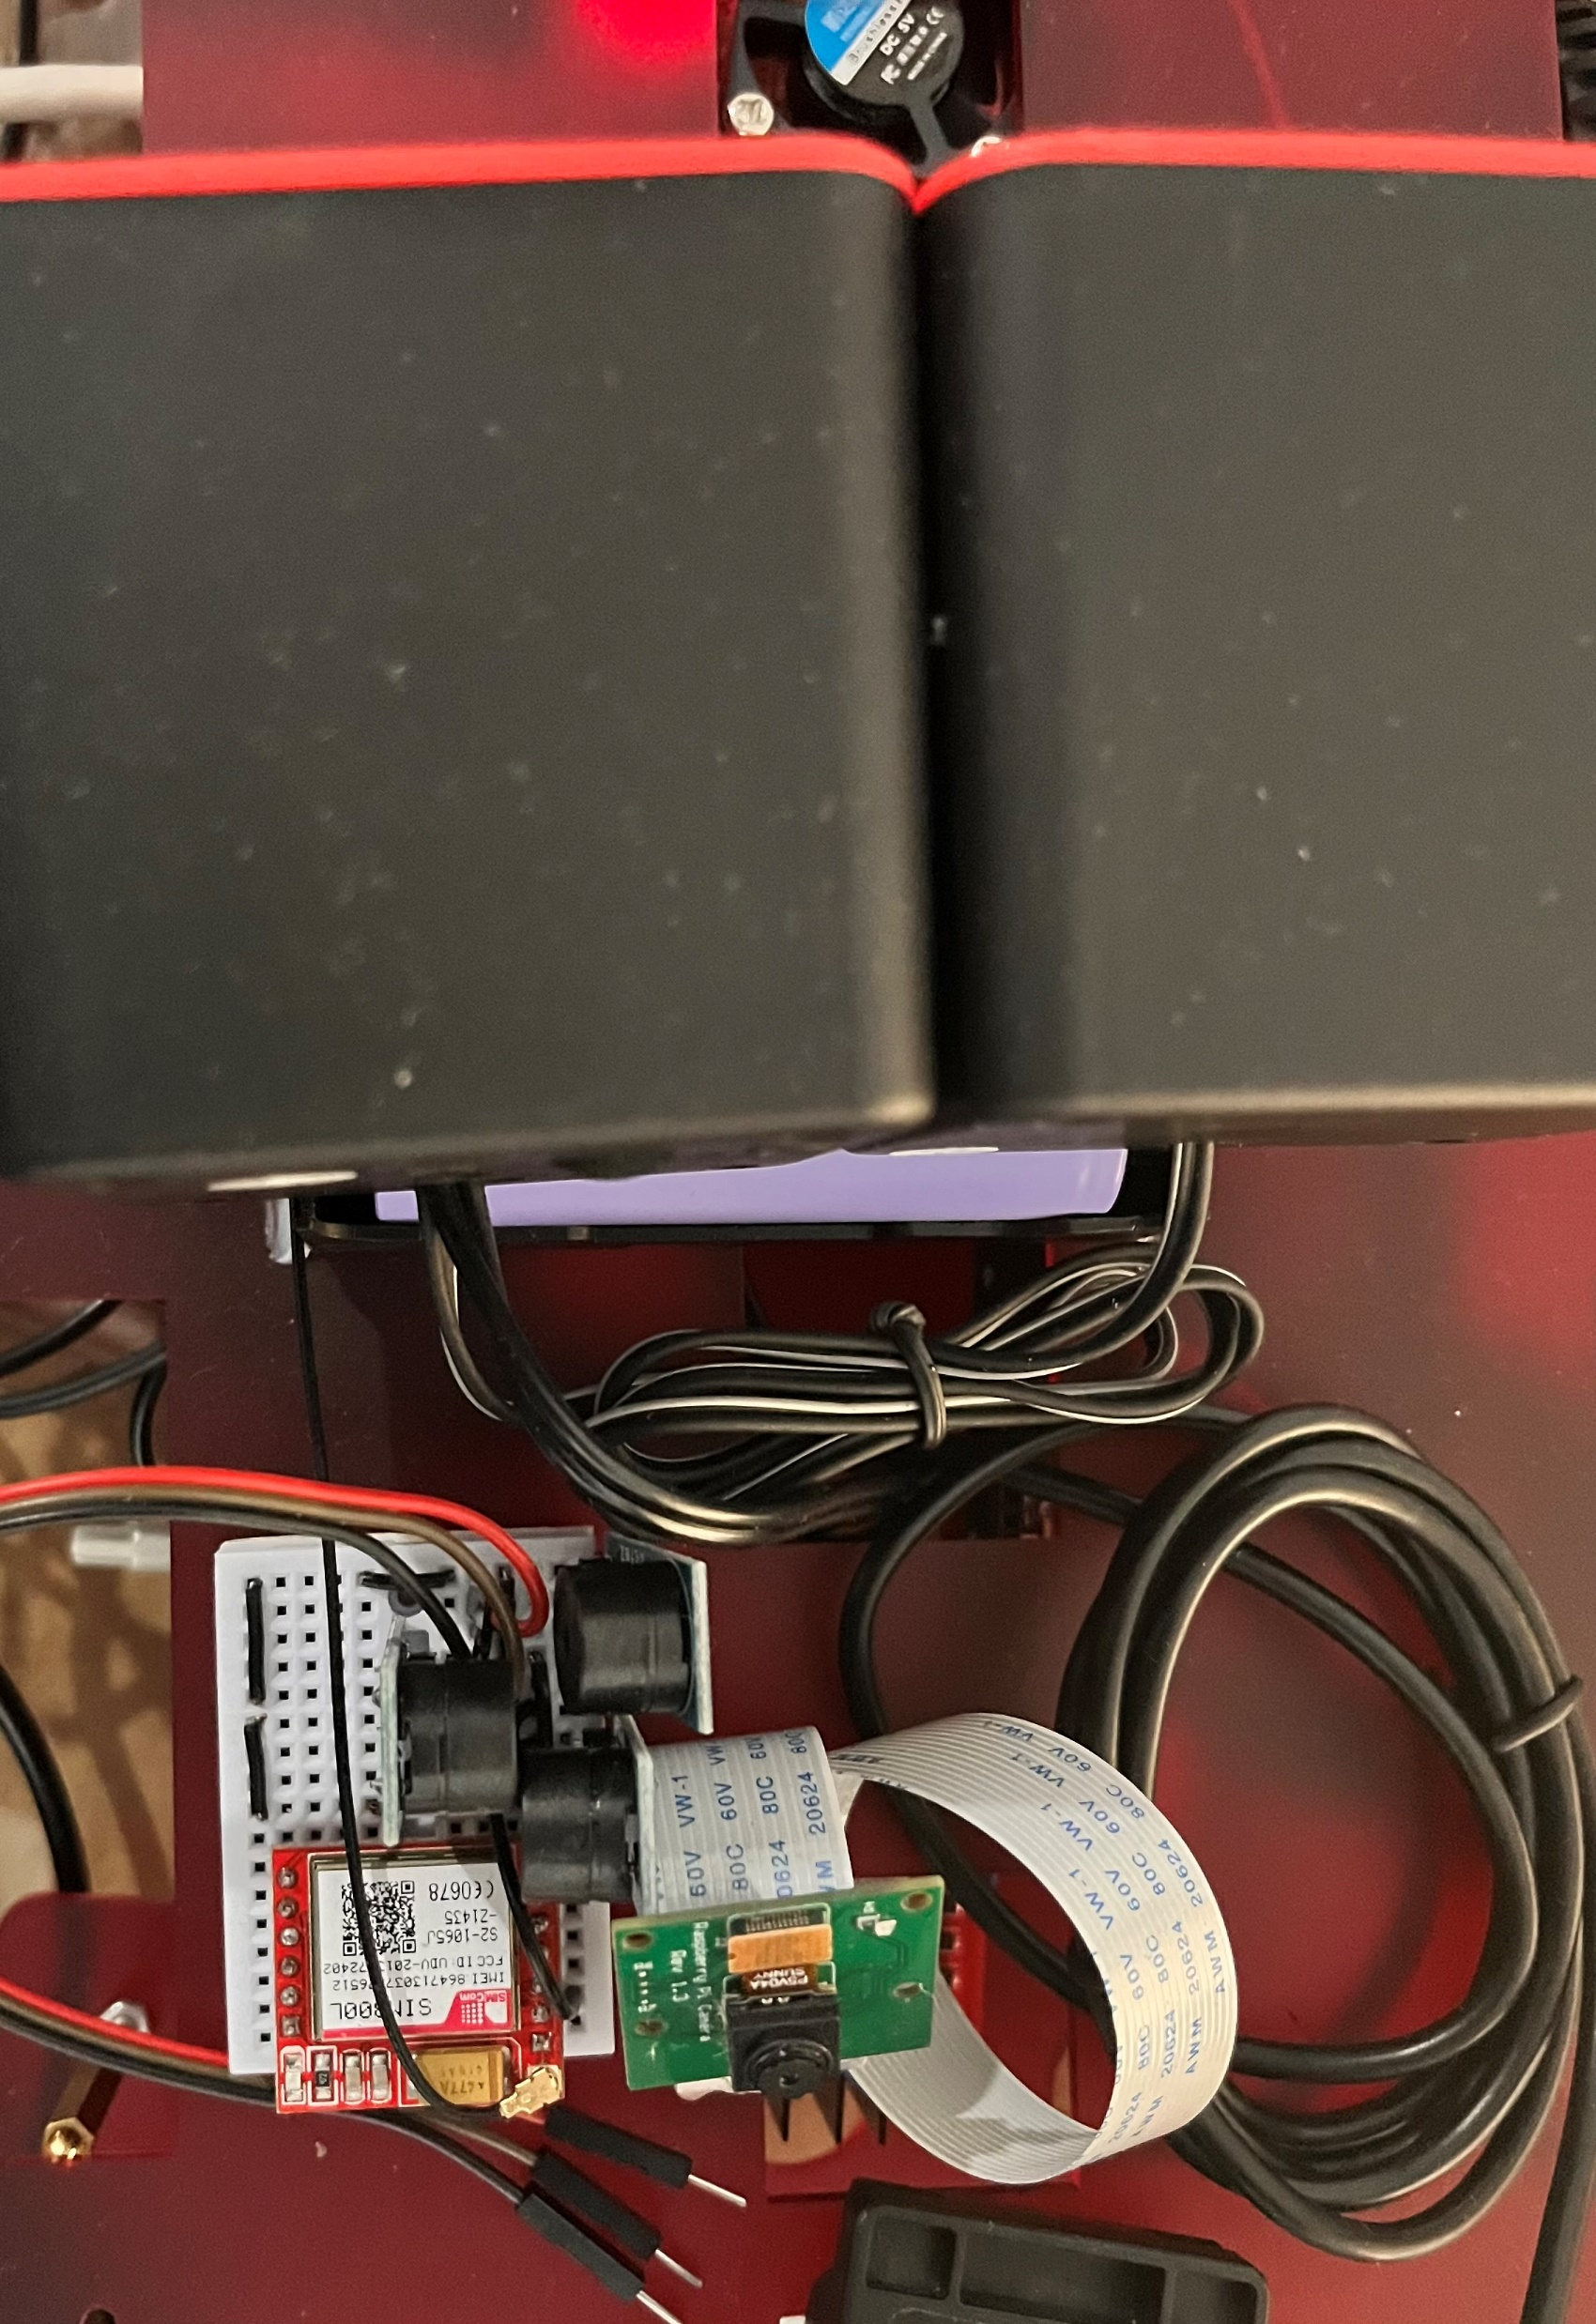
Project vidence
Project Evidence

Slide 46
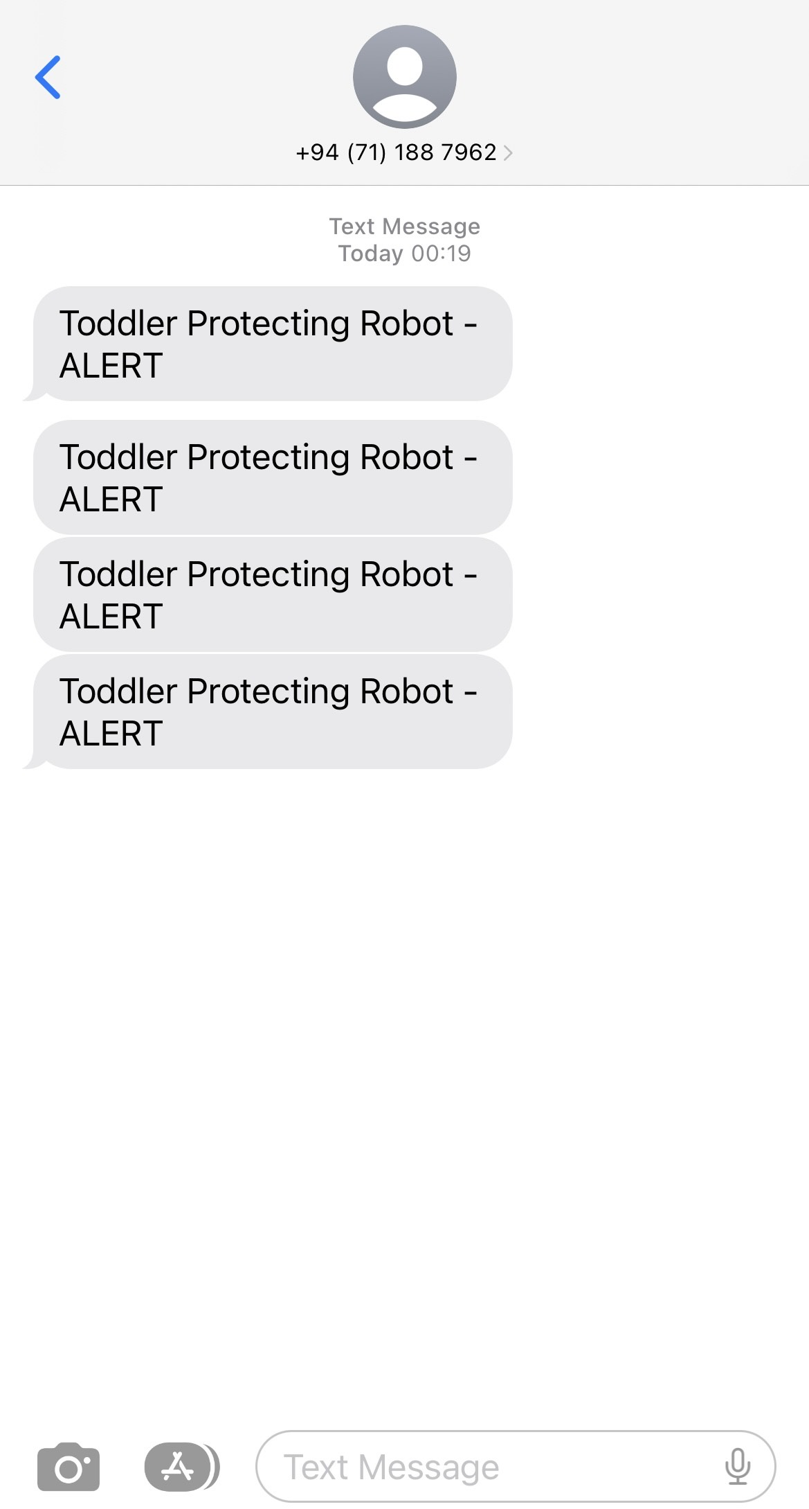
Project vidence
Project Evidence

Slide 47

Next Expected Progress
Complete the behaviors capturing part.
installation and completion of alerting system.
Creating an accurate and good alerting system

Slide 48

IT20093150 | Lakshan W. R
BSc (Hons) in Information Technology
Specializing in Computer Systems & Network Engineering

Slide 49
Component - 4
-Toddler Crying Detection & Automate Lullabies Playing System -

Slide 50
Introduction
Create a system to automatically generate music or lullabies by detecting toddler's crying situations.
Parents are able to create a playlist by adding toddler's favourite songs or lullabies via music application. (Such as Spotify).

Slide 51
Research Problem
Currently there is no proper system for parents to look after their children while they are away from home.
This system is designed as a remedy for the discomfort caused by the baby when it sleeps and cries.

Slide 52
Specific Objective
To provide opportunities for busy parents to look after their children when they are away from home.
To avoid disturbances when the baby sleeps and cries.
Sub Objectives
To give the opportunity to have a free mind for child as well as parents.

Slide 53
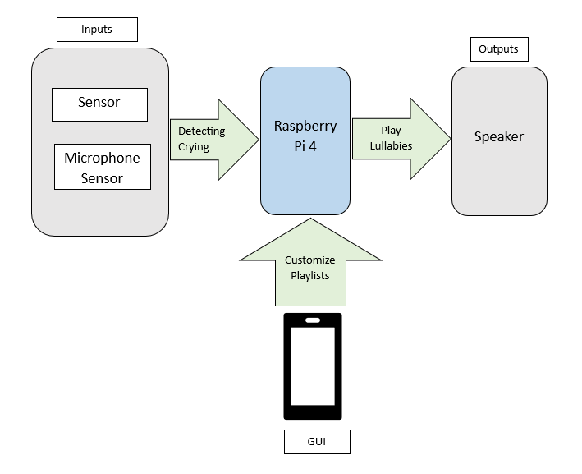
Methodology

Slide 54
Current Progress
Implementation of speakers for playing lullabies.
Generate a lullaby through the code.
Design the solid works.

Slide 55
Objectives and project completion
85%
70%
Crying Detection
Data set training and complete
Automatically play lullabies
Raspotify implementation

Slide 56
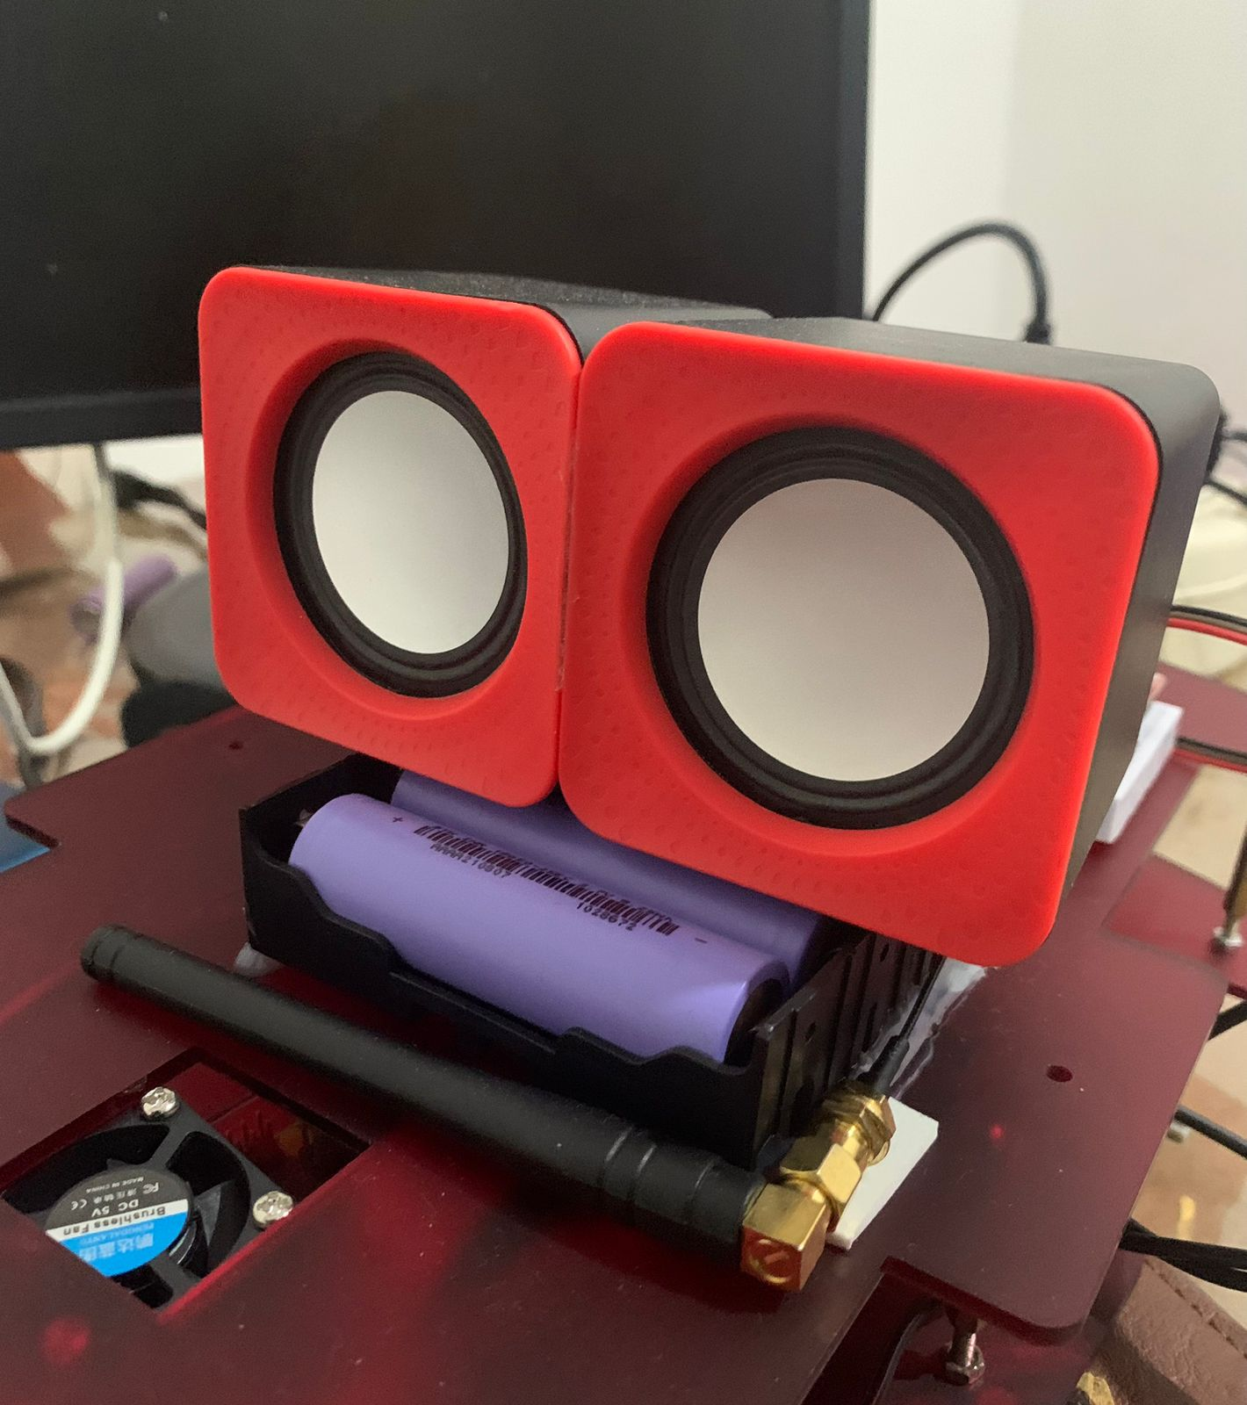
Project Evidence

Slide 57
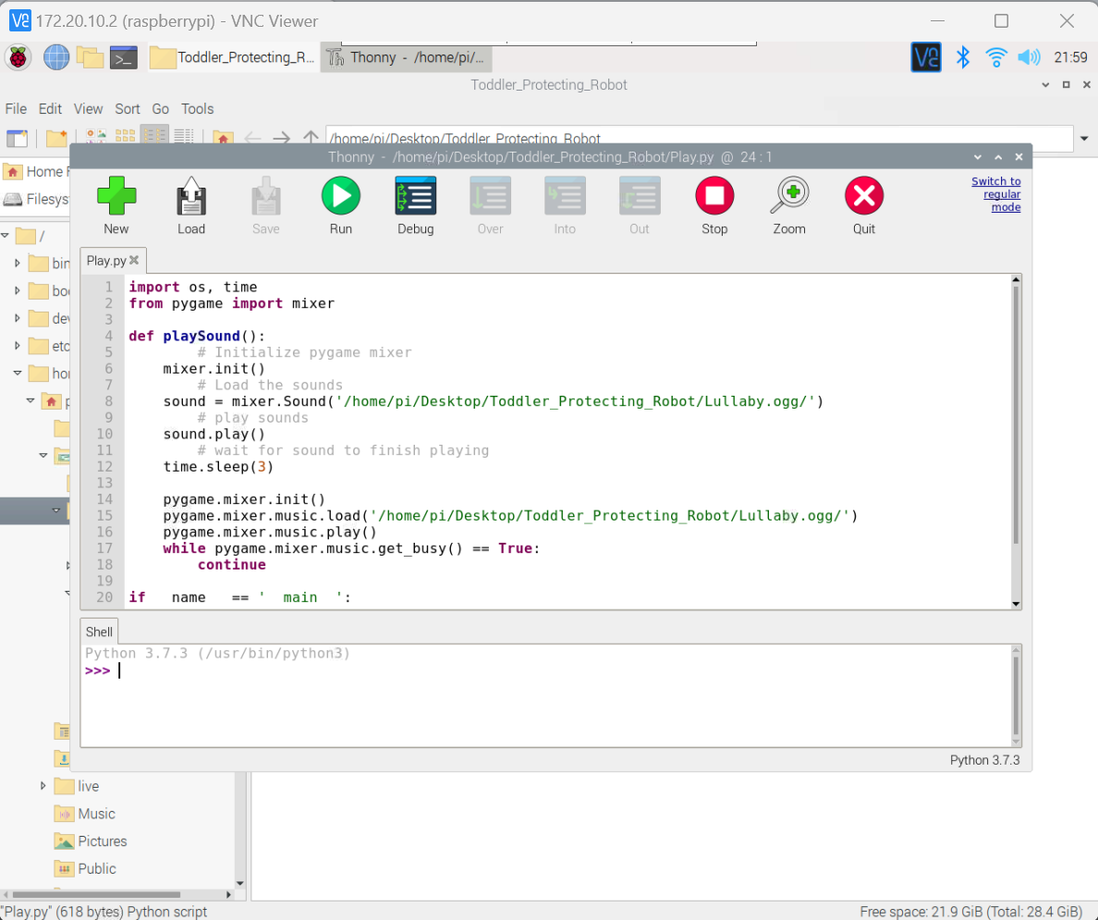
Project Evidence

Slide 58
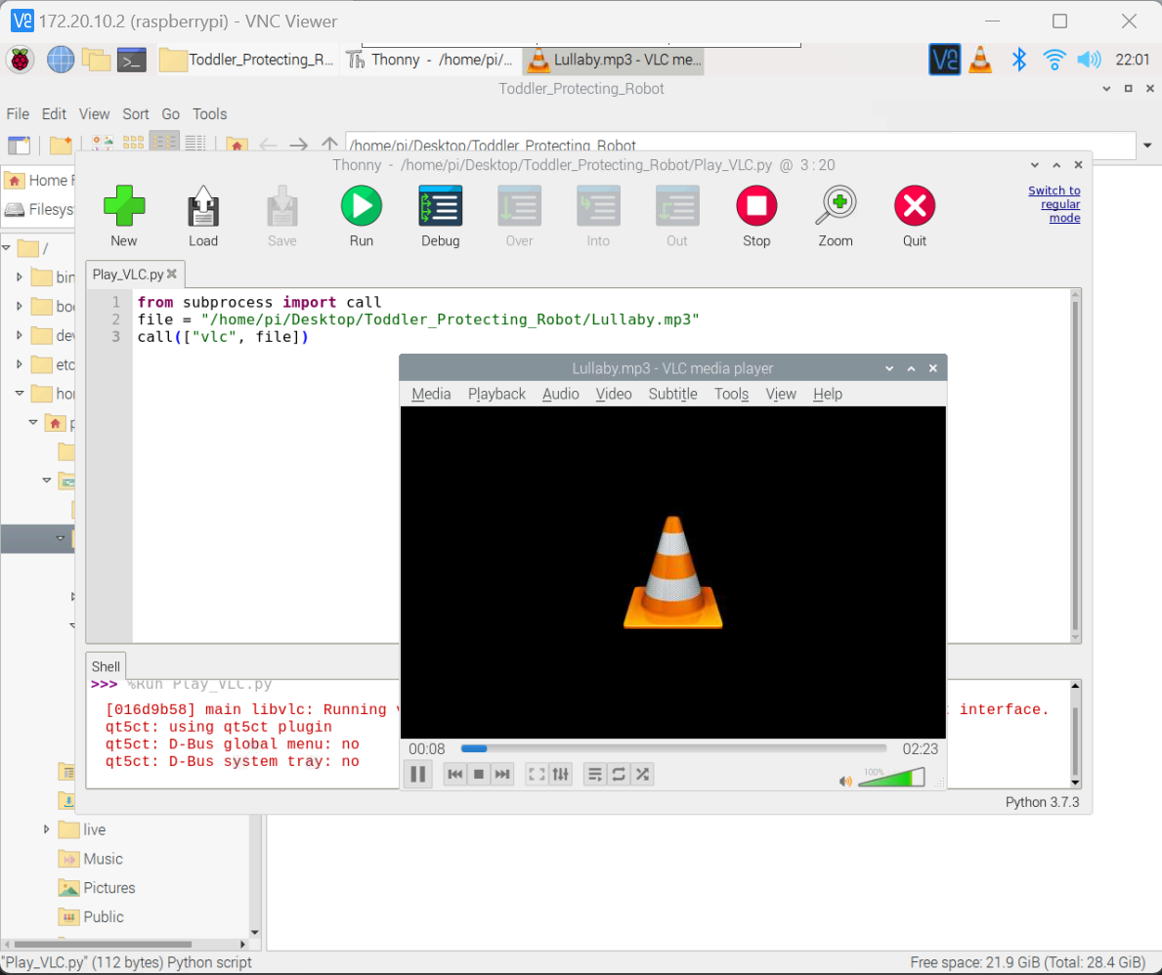
Project Evidence

Slide 59


Project Evidence

Slide 60
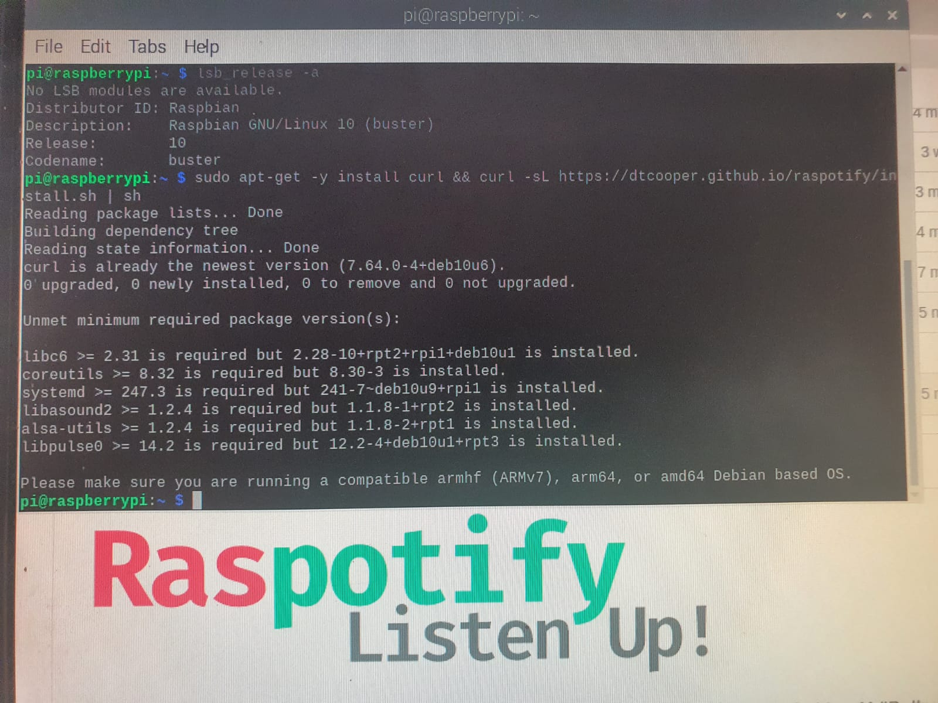
Project Evidence

Slide 61

Next Expected Progress
Implement and complete the crying detection system.
Implement complete the automated lullabies playing system
Implement and complete the Raspotify to lullabies playing system
Successfully complete the overall automated lullabies playing system.

Slide 62
Budget
Component | Quantity | Price (LKR)
Raspberry Pi 4 module | 1 | 45,000/=
Arduino mega board | 1 | 7500/=
Gear motor | 4 | 5000/=
Power bank | 1 | 5000/=
SIM module (800l) | 1 | 1100/=
Motor driver (L298N) | 2 | 365/=
N20 gear motor bracket | 4 | 100/=
M5 screws | 20 | 200/=
Web camera | 1 | 7000/=
Speaker | 1 | 1000/=
Passive buzzer | 3 | 255/=
Battery (18650) | 4 | 3100/=
Battery case | 1 | 200/=
Spacers | 10 | 120/=
Acrylic sheet | 1 | 4000/=
Ultrasonic sensor | 3 | 225/=
Other expenses |  | 10,000/=
Total |  | 90,165/=

Slide 63

Q & A

Slide 64
THANK YOU.

